Slide 1
Concise Communication
Shijie Zhang

Slide 2

Why: Everyone appreciates concise message
Long-winded talking to my manager
Thinking out loud
Skip the backstory
……
Notes:
Presentation
Team meeting
Talking turn
Elevator pitch

Slide 3
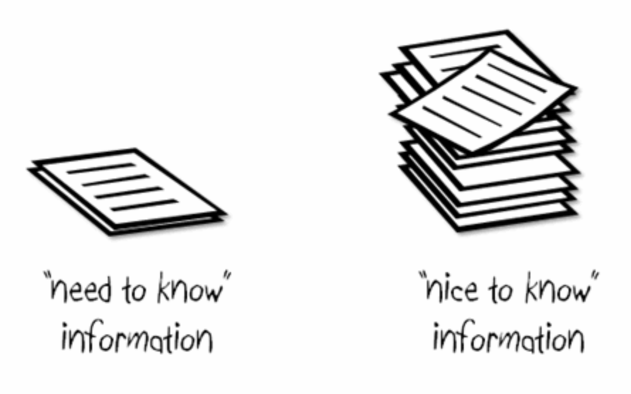
Why: Everyone appreciates concise message
Heart of msg
End your turn
Give them a chance to talk
Notes:
Shave words
Look for nods / verbal cues
Finish under time

Slide 4
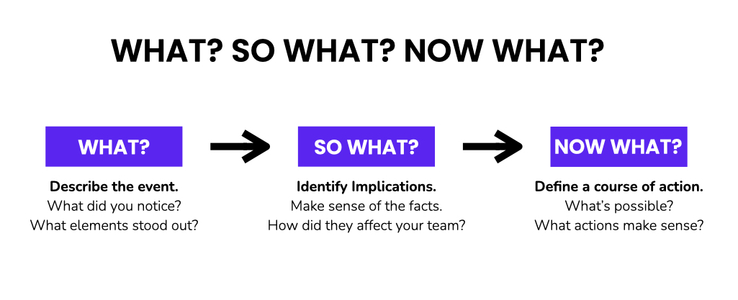
Structure - Simplest way to differentiate NEED and NICE
Notes:
What is your big idea: What’s your big idea
So what, why it is important
Now what, what is the action plan

Slide 5
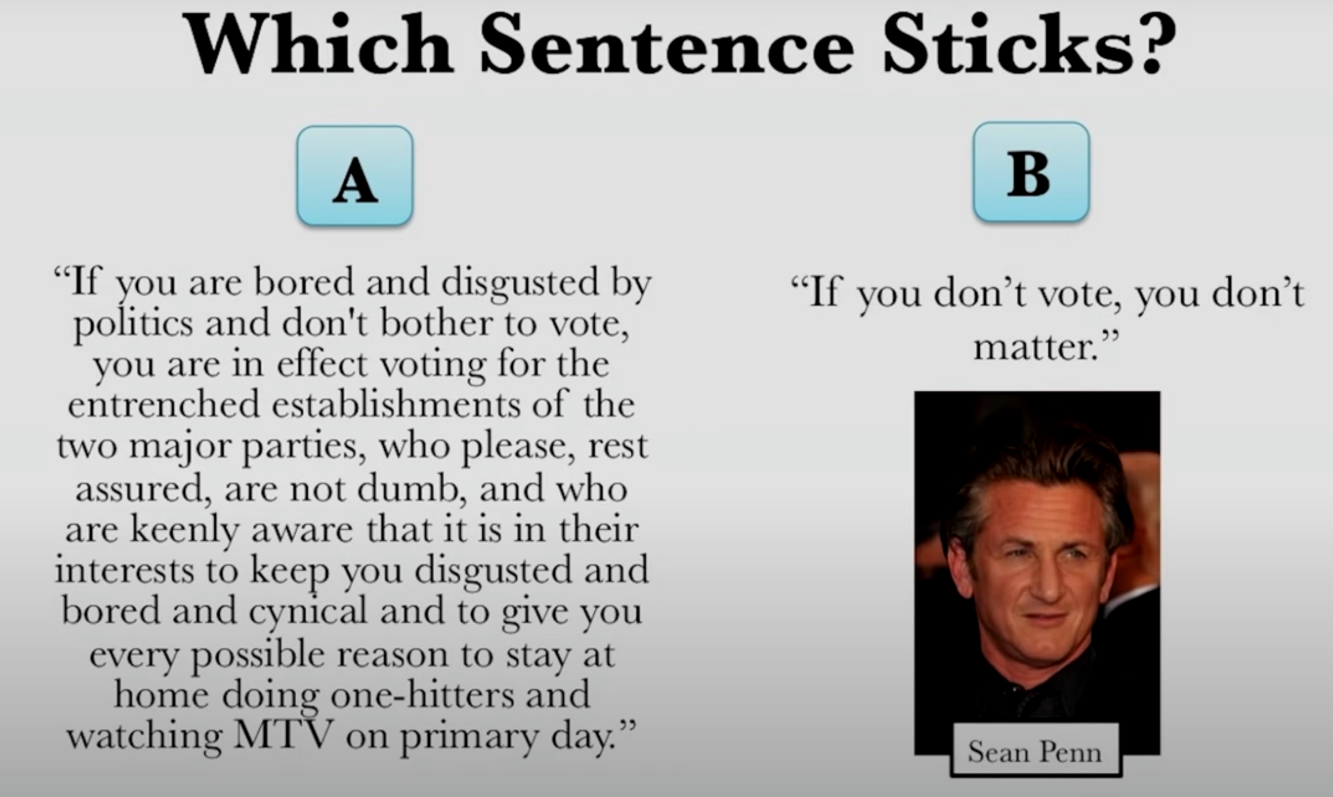
Why concise

Slide 6
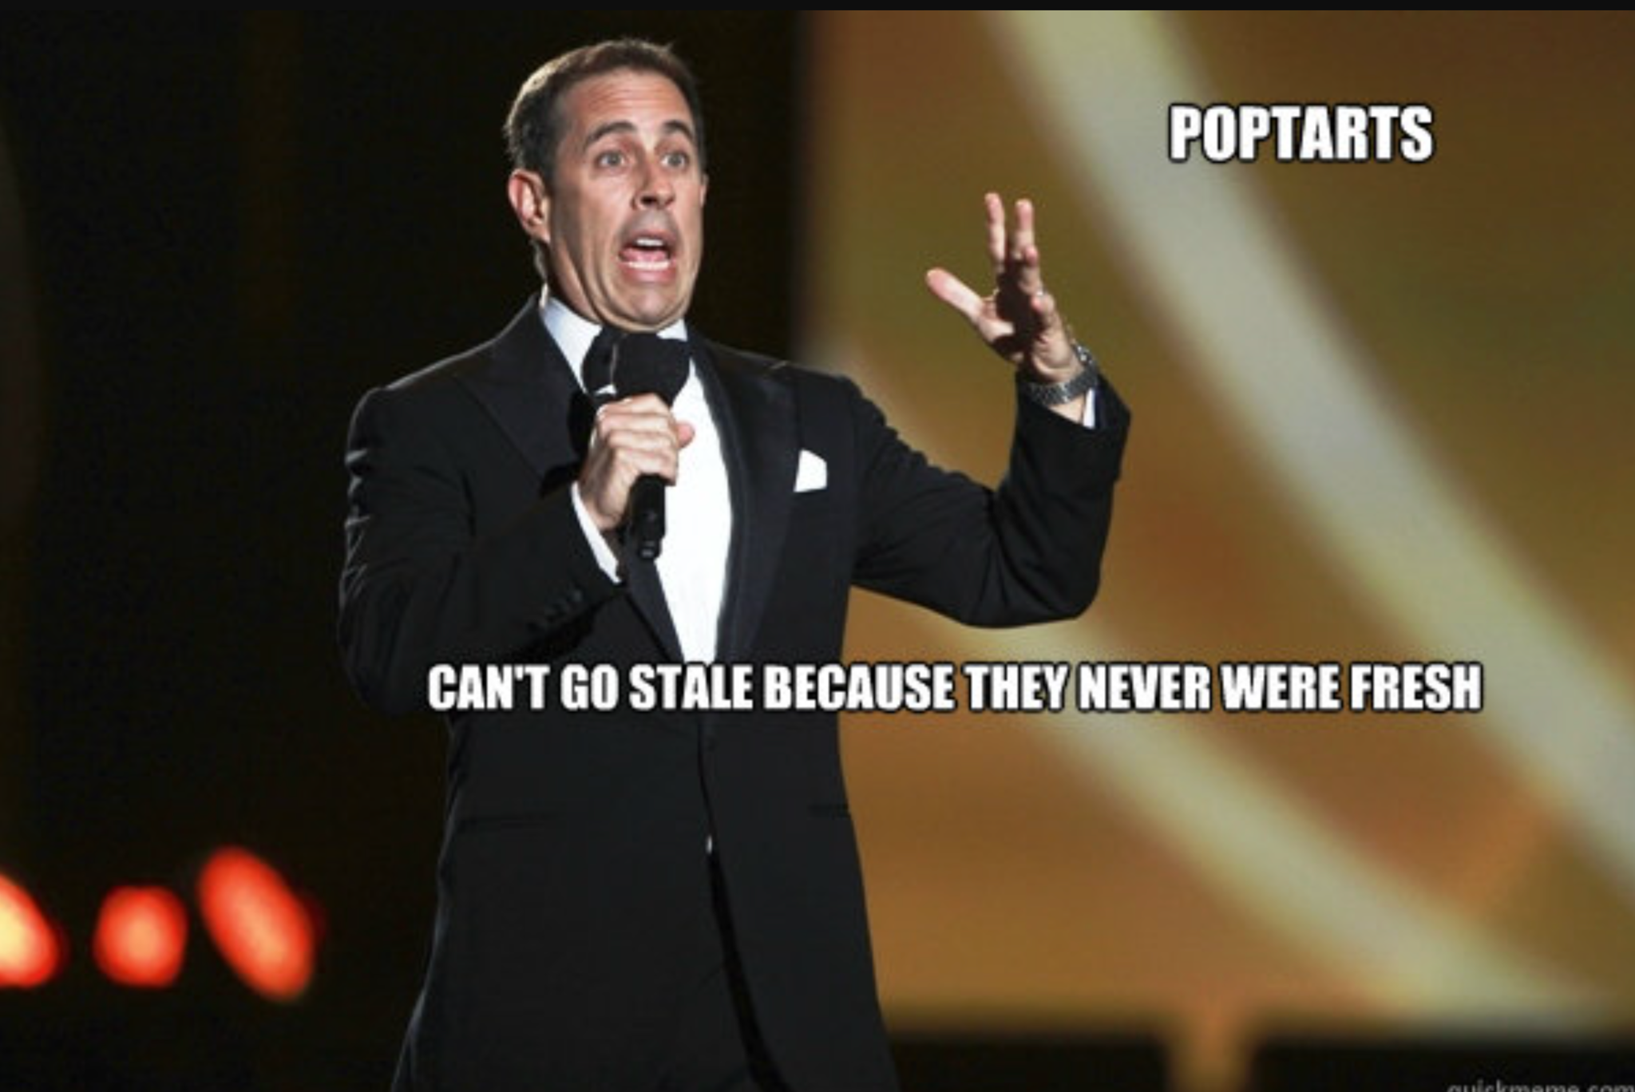
What: Concise overall message
Overall concise message
People will pay attention
People will remember
You will be more effective
Notes:
News headlines
Topic sentence of paragraphs
Items in a bullet list
People pay attention to what you say
People will remember what you say
You will be more impactful
You could lead more effectively

Slide 7


So what - Crave meanings before details
Notes:
When primitive man

Slide 8

Now what - Rule of Three
Three things
Most stable / Backup plans
Remember

Slide 9
Summary
Need to know vs nice to know
Easiest to pick Need-to-Know is structure
What - Short message sticks
So what - Crave meanings before details
Now what - Rule of three

Slide 10
References
https://www.youtube.com/watch?v=6pYSbdGiDYw&ab_channel=CommunicationCoachAlexLyon
https://www.youtube.com/watch?v=DRtXJ2ih0AI&list=PLxq_lXOUlvQCRZoYd1B7gtCSIlZnYOa11&index=3&t=2312s&ab_channel=StanfordGraduateSchoolofBusiness
https://www.youtube.com/watch?v=QBrtY48kaus&t=156s&ab_channel=LighthouseCommunications

Slide 11
